Slide 1
《专业写作与口头表达》
漆进
信息与通信工程学院

Slide 2
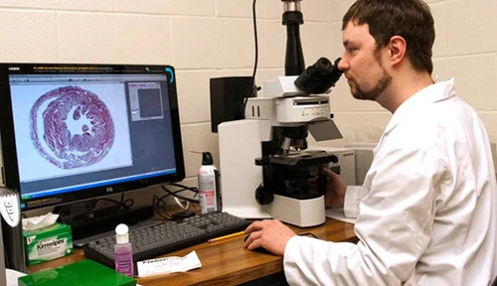
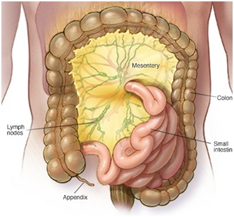
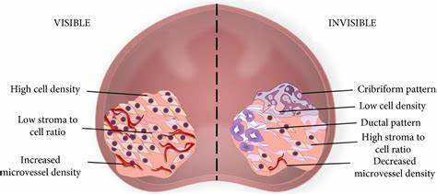
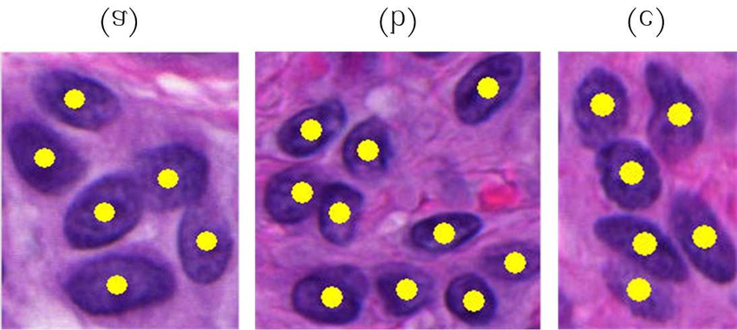
Dataset and Code (Pytorch) for Histopathological Image Analysis
MHIST: A Minimalist Histopathology Image Analysis Dataset

Slide 3
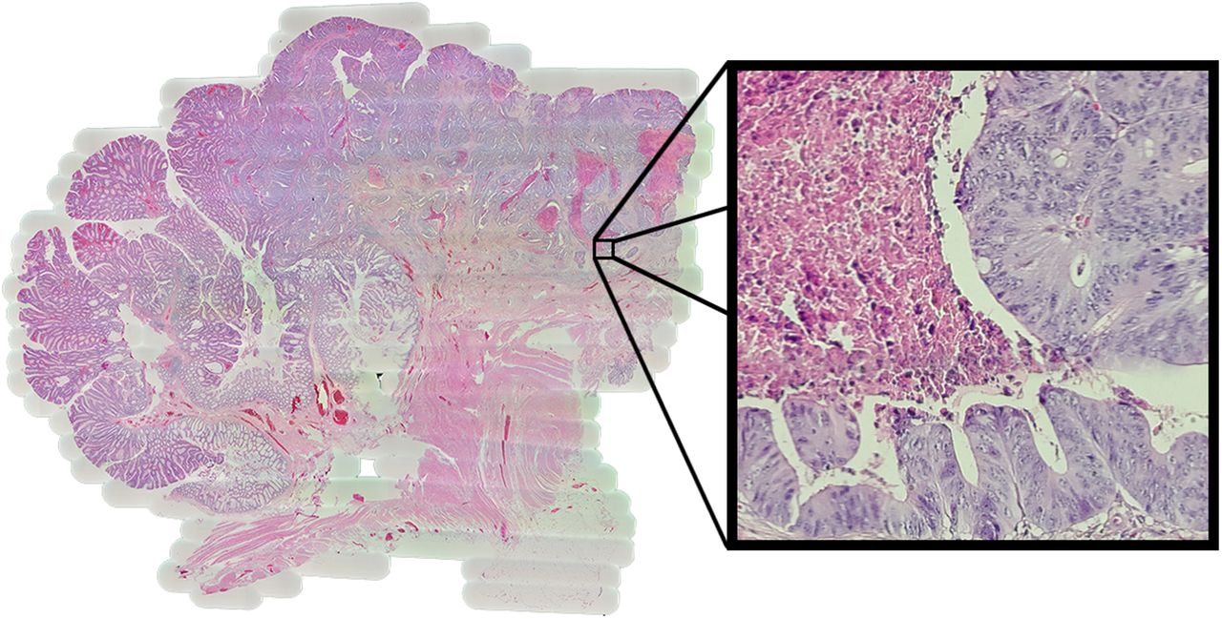
A whole slide

Slide 4

课时安排
周 | 日期 星期五 5-6 | 内容 | 地点
2 | 2023-03-03 | 概述&文献检索（课后准备及阅读综述, ppt 说明病理分析概念、方法、综述结构等）（组织病理图分析） | 品学楼A110
3 | 2023-03-10 | 文献综述：组织病理图分析方法整理、内容、格式讨论（阅读更多文献，模仿写作综述，word 文档）（组织病理图分析） | 品学楼A110
4 | 2023-03-17 | 文献综述写作分享 （ppt和word文档，课后完善提交第一版: 课代表收齐email:jqi@uestc.edu.cn） | 品学楼A110
5 | 2023-03-24 | 文献综述写作分享 （ppt和word文档，课后完善提交第二版: 课代表收齐email:jqi@uestc.edu.cn） | 品学楼A110
6 | 2023-03-31 | 专利写作讨论：格式、内容讨论（课后准备及阅读专利, ppt 说明专利写作方法、结构等） | 品学楼A110
7 | 2023-04-07 | 专利写作分享 （ppt和word文档，课后完善提交第一版: 课代表收齐email:jqi@uestc.edu.cn） | 品学楼A110
8 | 2023-04-14 | 专利写作分享 （ppt和word文档，课后完善提交第二版: 课代表收齐email:jqi@uestc.edu.cn，写学期总结ppt: 1. 时间，地点，人物，用什么东西做了什么事，包括综述和专利附件；2. 学到了什么，失去了什么，个人感想和意见，附上集体合照） | 品学楼A110
9 | 2023-04-21 | 学期总结ppt展示讨论 | 品学楼A110

Slide 5
课程网站
https://github.com/jinqijinqi/CompositionAndCommunication
所有课程相关的资料及活动将在上述网站中展示，可以在任何时间和地点阅读和下载

Slide 6
提纲
如何检索论文与专利？
如何写一篇综述？
引言
正文
图、公式、表
结论
参考文献

Slide 7
第二章 文献检索和综述
3. 如何看一篇论文/专利
找到了文献，怎么读才是正确的姿势呢？
学位论文
又叫
大论文
期刊论文、会议论文
又叫
小论文
专利

Slide 8
第二章 文献检索和综述
3. 如何看一篇论文/专利
期刊论文
一个典型的期刊论文，都讲啥呢
Abstract （摘要）
Introduction （引言）
Results （研究成果）
Analysis （分析讨论）
Conclusion （结论）
Acknowledgement（致谢）
References （参考文献）
应该先看，确认这篇论文是不是你关心的topic
如果你是新手，建议仔细看，
想想别人是怎么引入主题的
而且，还可以进一步找到新的文献
本文的核心内容，判断本文的科学价值
阅读方法：看图说话
简要的总结，
一般提炼了本文最有价值的东西

Slide 9
课堂练习
快速阅读这篇论文
Deep neural network models for computational histopathology: A survey
（文件pdf见 https://github.com/jinqijinqi/CompositionAndCommunication）

Slide 10
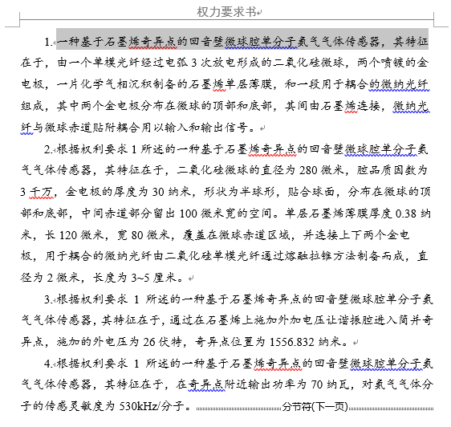
第二章 文献检索和综述
3. 如何看一篇论文/专利
专利
一个典型的专利提纲，都讲啥呢
发明摘要
权利要求书
发明书具体内容
实施案例举例。。。
附图

Slide 11
第二章 文献检索和综述
3. 如何看一篇论文/专利
总结一下
抓核心：找目的，贴标签
讲效率：重概念，泛分析
再精读：仔细把握内在逻辑与科学技术要点
回头想：这篇文献能帮助我干点什么

Slide 12
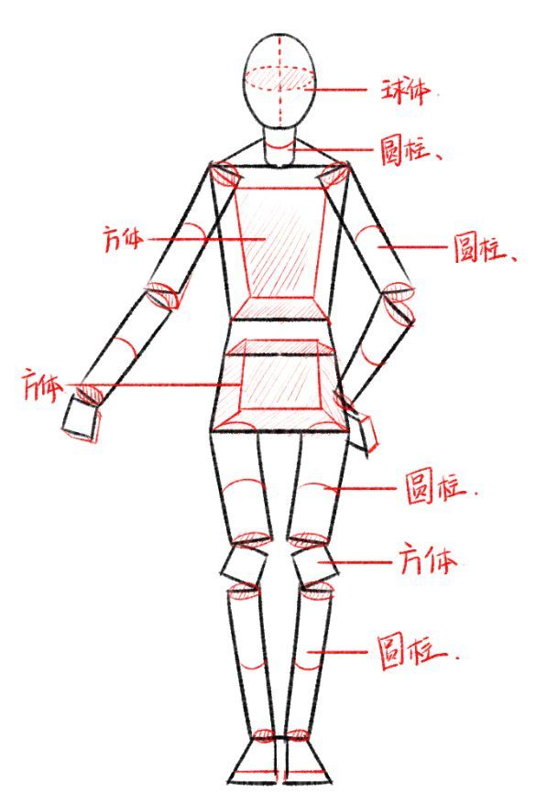
第二章 文献检索和综述
3. 如何看一篇论文/专利
架构美学欣赏

Slide 13
第二章 文献检索和综述
1. 什么是综述报告
报道某领域综合进展的文献
一般不需要
原创研究
注重体系性总结
为科研工作者们提供一揽子的参考

Slide 14
课堂练习
快速阅读一篇中文综述
基于深度学习的数字病理图像分割综述与展望
（文件pdf见https://github.com/jinqijinqi/CompositionAndCommunication）

Slide 15
第二章 文献检索和综述
2. 我们要求的综述报告长什么样？流程要求
流程
要求
请统一
标题
作者和作者单位
摘要（150字左右）
关键词（4~5个关键词）
英文标题
英文摘要
英文关键词
引言
子标题1
子标题2
。。。
结论
参考文献（不少于10篇）
抬头
图文
并茂
正文（不少于2000字）

Slide 16
第二章 文献检索和综述
2. 我们要求的综述报告长什么样？格式要求
全文用A4纸
标题（黑体三号字）
作者和作者单位（仿宋五号字）
摘要（仿宋五号字，摘要两个字加粗）
关键词（仿宋五号字）
英文标题
英文摘要
英文关键词
子标题（仿宋四号字）
正文（仿宋小四）
其中作图：宽度16cm，图注：5号字
参考文献（子标题仿宋四号字，其他五号字）
文献格式很重要
打开你的WORD
如何用好WORD
也是一门技术
格式
要求
请统一
可以去“电子科技大学学报”、“中国科学”下载模版
Times New Roman

Slide 17
第二章 文献检索和综述
2. 我们要求的综述报告长什么样？格式要求
如何用好WORD
也是一门技术
插播介绍，课外知识：常用的写作软件有哪些？
Microsoft Office系列，一般WORD用于书写，PPT用于处理图像，EXCEL用于数据管理
Latex编辑器，用编程的手法操作，独特的优势是，格式和排版是全自动的
EndNote和Mendeley，文献管理工具，用于参考文献格式校准和插接。

Slide 18

第二章 文献检索和综述
2. 我们要求的综述报告长什么样？格式要求
Word Or LaTex?
LaTeX 与 Word 是两种不同类型的文本编辑处理系统，各有所长，如果要对文字编辑性能和使用便捷程度等作综合评比，Word 明显优于 LaTeX，仅“所见即所得”一项，Word 就会赢得绝大多数用户，但要仅限定在学术报告和科技论文方面，评比结果就不同了。

Slide 19
第二章 文献检索和综述
2. 我们要求的综述报告长什么样？格式要求
文献
格式
期刊格式
Fu X H, Jiang H Y, Zhang J, et al. Preparation of short and medium wave infrared anti-reflective coating based on chalcogenide glass[J]. Chinese Journal of Lasers, 2017, 44(9): 0903002.
付秀华,姜洪妍,张静,等. 基于硫系玻璃的短中波红外减反膜研制[J]. 中国激光, 2017, 44(9): 0903002.
Feng Y J, Wang X J, Ke W W, et al. Numerical analysis to four-wave mixing induced spectral broadening in high power fiber lasers[J]. Proceedings of SPIE, 2015, 9255: 92550Q.
图书格式
Yariv A, Yeh P. Optical electronics in modern communications[M]. Chen H M, Shi W H, Wang J L, et al, Transl. 6th ed. Beijing: Electronic Industry Press, 2014: 15-28.
阿曼·亚里夫, 波奇·耶赫. 光子学: 现代通信光电子学[M]. 陈鹤鸣, 施伟华, 汪静丽, 等, 译. 6版. 北京: 电子工业出版社, 2014: 15-28.

Slide 20
第二章 文献检索和综述
2. 我们要求的综述报告长什么样？格式要求
文献
格式
学位论文格式
Huang H. Design and manufacture of branch optic waveguide phase modulator for fiber optic gyroscope[D]. Chengdu: University of Electronic Science and Technology of China, 2004: 20-28.
黄禾. 光纤陀螺仪用集成光波导Y分支相位调制器的设计与制作[D]. 成都: 电子科技大学, 2004: 20-28.
会议论文格式
Chen S T, Cheng J H, Gao W. A phase modulation method for improving the scale factor stability of fiber-optic gyroscope[C]//Proceedings of 2008 IEEE International Conference on Mechatronics and Automation, 2008, 978: 37-42.
Shi Y, Mallik R K, Letaief K B. Power control for relay-assisted wireless systems with general relaying[C]. IEEE International Conference on Communications, 2010: 11412565.

Slide 21
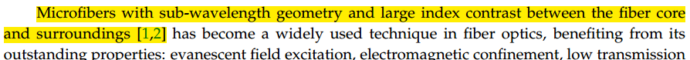
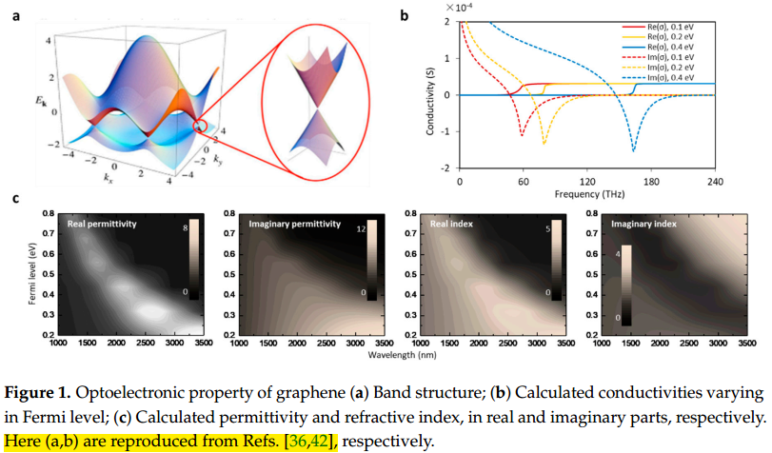
第二章 文献检索和综述
2. 我们要求的综述报告长什么样？引用要求
综述的
学术
道德
原则
请务必注意
避免盗版嫌疑的两个凡是：
凡是引述他人的，一律需要引用
凡是别人的图，一律在图注引用

Slide 22
电子科技大学学生纪律处分规定（试行） （校学通知[2005]105号）
第十四条 剽窃、抄袭他人研究成果，情节严重的，给予开除学籍处分。

Slide 23
关于学术规范的法规与条例
《中华人民共和国著作权法》
《中华人民共和国学位条例》
国务院学位委员会关于在学位授予工作中加强学术道德和学术规范建设的意见，学位〔2010〕9号
教育部《高等学校科学技术学术规范指南》
同方知网《学术期刊论文不端行为的界定标准》
同方知网《科研诚信技术管理中心学术规范研究资料》
The IEEE Code of Ethics
学术道德规范，中国计算机学会 - CCF

Slide 24
其他学术规范的规定
教育部《高等学校科学技术学术规范指南》
同方知网《学术期刊论文不端行为的界定标准》
同方知网《科研诚信技术管理中心学术规范研究资料》

Slide 25
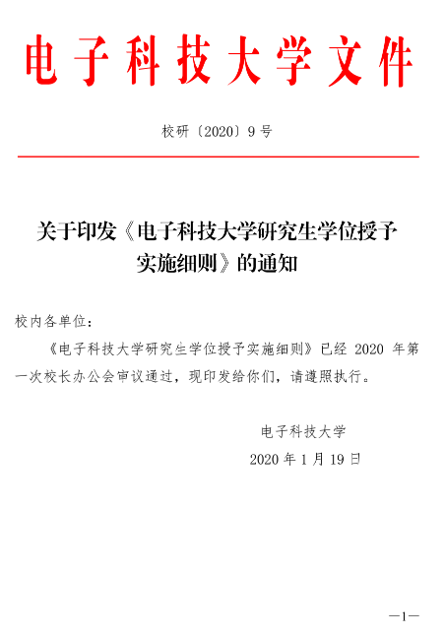
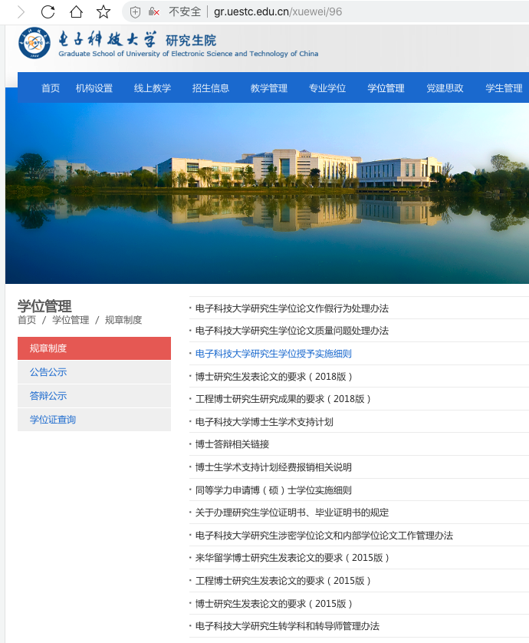
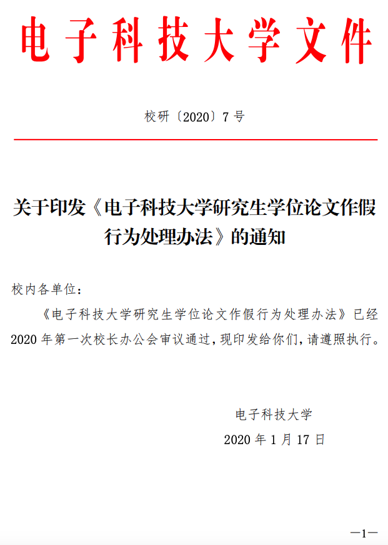
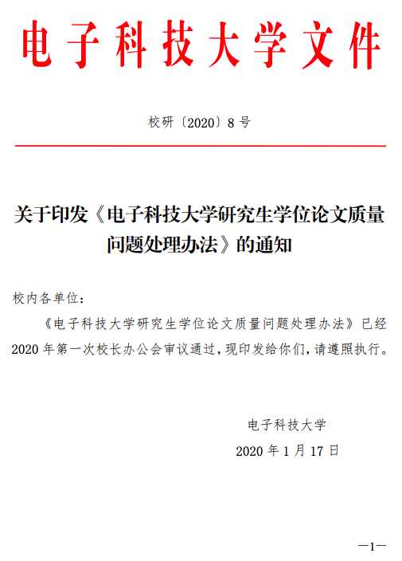
学校的规章制度

Slide 26
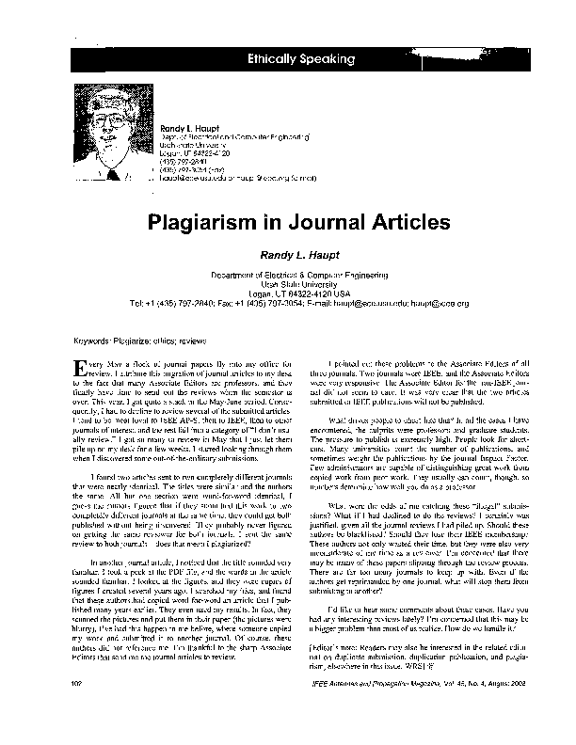
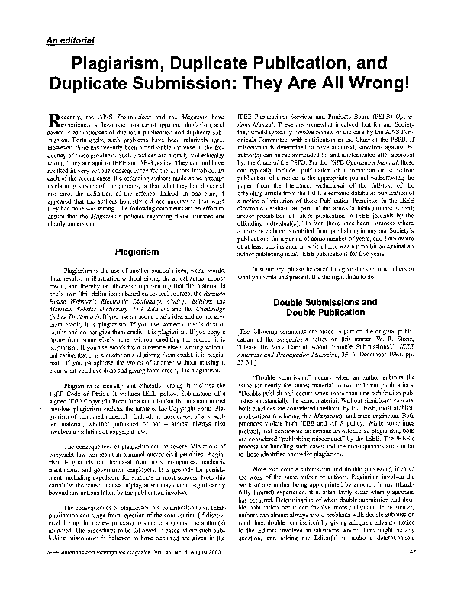
IEEE关于剽窃(Plagiarism)的定义和讨论（双击PDF可打开）

Slide 27
IEEE相关链接
http://www.ieee.org/web/publications/rights/ID_Plagiarism.html
http://www.ieee.org/portal/site/tionline/menuitem.130a3558587d56e8fb2275875bac26c8/index.jsp?&pName=institute_level1_article&article=tionline/legacy/inst2004/dec04/12w.pub.xml

Slide 28
IEEE对论文剽窃的区分及处罚
IEEE的文件对论文剽窃区分为5个层次：
一、未注明出处地全文复制一篇论文，将导致在该文章记录中注明违规，并吊销违规者在IEEE刊物上的发表权利达5年。
二、未注明出处地大量复制（达一半的篇幅）一篇论文，处罚同上。
三、未注明出处地照搬句子、段落或插图。可能导致在该文章记录中注明违规，并且必须提交向原始作者的书面道歉以避免被吊销发表权利达3年。

Slide 29
IEEE对论文剽窃的区分及处罚(续)
四、未注明出处地不恰当地复述整页或整段内容（通过改变个别单词、 词组或重排句子顺序）。要求做出书面道歉以避免被吊销发表权利和可能在该文章记录中注明违规。
五、注明出处地复制一篇论文的很大一部分，而没有清楚地表明谁做了或写了什么。要求书面道歉，并且必须修改论文以避免被吊销发表权利。

Slide 30
原文
The Five Levels Of Plagiarism
1. Uncredited verbatim copying of a full paper. Results in a violation notice in the later article’s bibliographic record and a suspension of the offender’s IEEE publication privileges for up to five years.
2. Uncredited verbatim copying of a large portion (up to half) of a paper. Results in a violation notice in the later article’s bibliographic record and a suspension of publication privileges for up to five years.
3. Uncredited verbatim copying of individual elements such as sentences, paragraphs, or illustrations. May result in a violation notice in the later article’s bibliographic record. In addition, a written apology must be submitted to the original creator to avoid suspension of publication privileges for up to three years.
4. Uncredited improper paraphrasing of pages or paragraphs (by changing a few words or phrases or rearranging the original sentence order). Calls for a written apology to avoid suspension of publication privileges and a possible violation notice in the later article’s bibliographic record.
5. Credited verbatim copying of a major portion of a paper without clear delineation of who did or wrote what. Requires a written apology, and to avoid suspension, the document must be corrected.
The guidelines also make recommendations for dealing with repeated offenses.

Slide 31
第二章 文献检索和综述
3. 标题怎么写？
标题，作为行文的名字，是书写的第一步，古语云：
名不正，则言不顺。
中文：一般不宜超过25个字
英文：一般不宜超过10个单词
一般形式：定语 + 名词 的 组合
比如：
基于有源相控阵雷达的信号复用技术研究
用神经网络深度学习方法实现的二维拓扑材料筛选
基于石墨烯的光电子信号发生器、调制器和探测器：综述
方法
类别
范围
技术路线
。。。
等描述性词
核心内容
目标：简单+明确

Slide 32
第二章 文献检索和综述
4. 摘要怎么写？
摘要，可以理解为标题的拓展，让你有机会把标题讲的更透彻，
更诱人，让人有读下去的兴趣。
所以当然是围绕标题来进行阐述
摘要，作为精简的全文，每一句话都应该有独立的意义，每一句话都不是废话。
写好摘要，有没有推荐的套路呢？
当然有。简单的摘要只需要5句。
按句子拆分：
第一句：对科学背景进行简要回顾
第二句：找出科学背景和本文的连接点（focus开始啦）
或者提出科学问题、技术难题（选题意义来啦）
第三句：提出本文的主要内容，核心信息和重点工作
第四句：点出本文的技术路线，标出创新点、特点，等等
第五句：拓展提升，强调意义

Slide 33
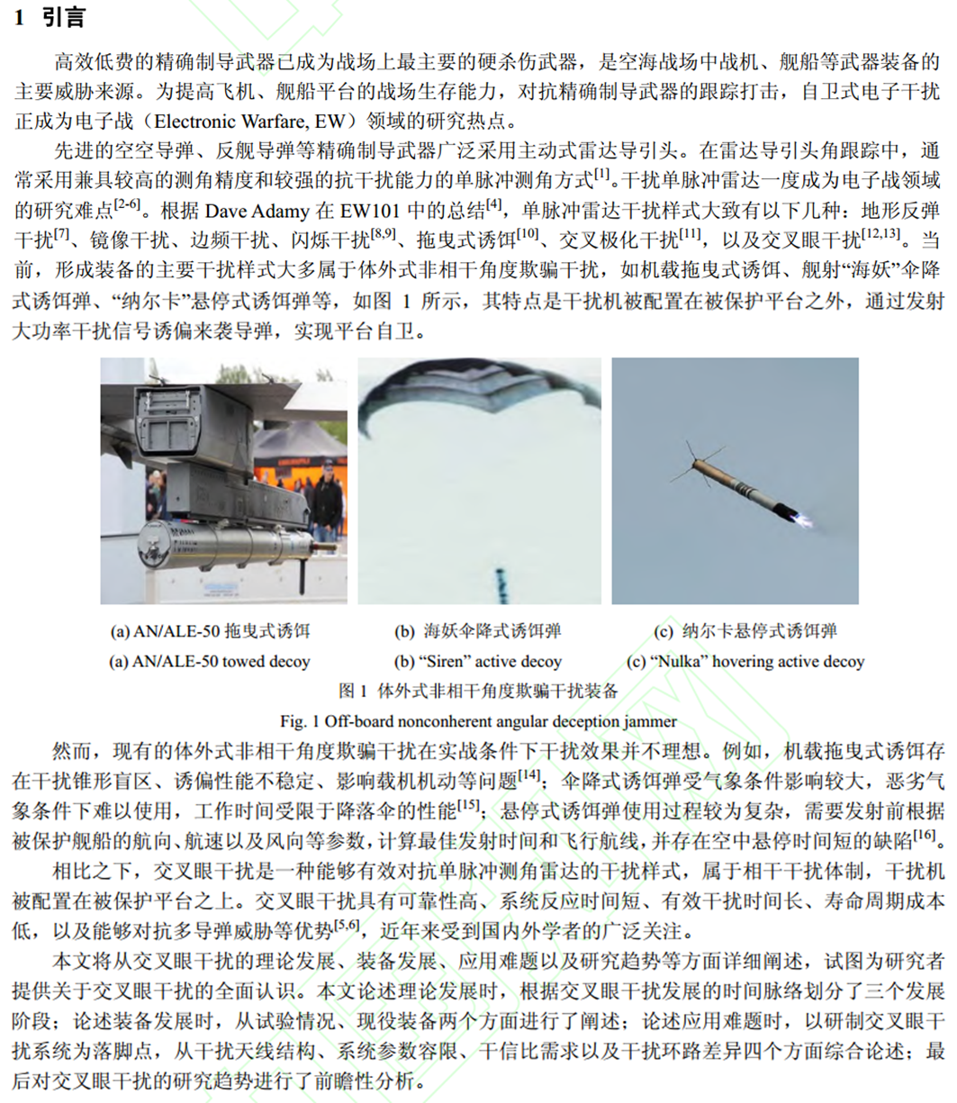
第二章 文献检索和综述
5. 综述的引言怎么写？
引言就是
摘要第一句和第二句
的拓展
和英语写作要求一样
一般是总分格式
每一段的第一句囊括本段的核心主旨

Slide 34


第二章 文献检索和综述
6. 正文怎么分段、怎么布局？
逻辑，或者说程序的核心思想：模块化
计算机语言的成功，
就在于模块化的函数调用。
科技写作的要则，
在于子标题的分级
同一级的子标题，呈现并列关系或递进关系
不同级的子标题，呈现总分关系或组成关系

Slide 35
第二章 文献检索和综述
7. 子标题分完了，每一段怎么写？
以图讲话，图文并茂。
结构上依然遵循总分原则，每段的第一句话标明本段主旨。

Slide 36
第二章 文献检索和综述
8. 既然是看图说话，怎么才能好好描述一个图？
专业写作中的图，主要分为三类：
（1）概念图和照片，主要用于描述形象（特点，一般都比较好看，是判断作者态度和水平的一个窗口）
（2）过程图和程序图，主要用于展示逻辑（特点：一般作为核心阐述点之一，注重各种关系，连词的聚居地）
（3）数据图和统计图，主要用于说明定量（特点，坐标轴和单位）
值得指出的是，每一幅图都应该要有标题，并在正文中呼应。

Slide 37
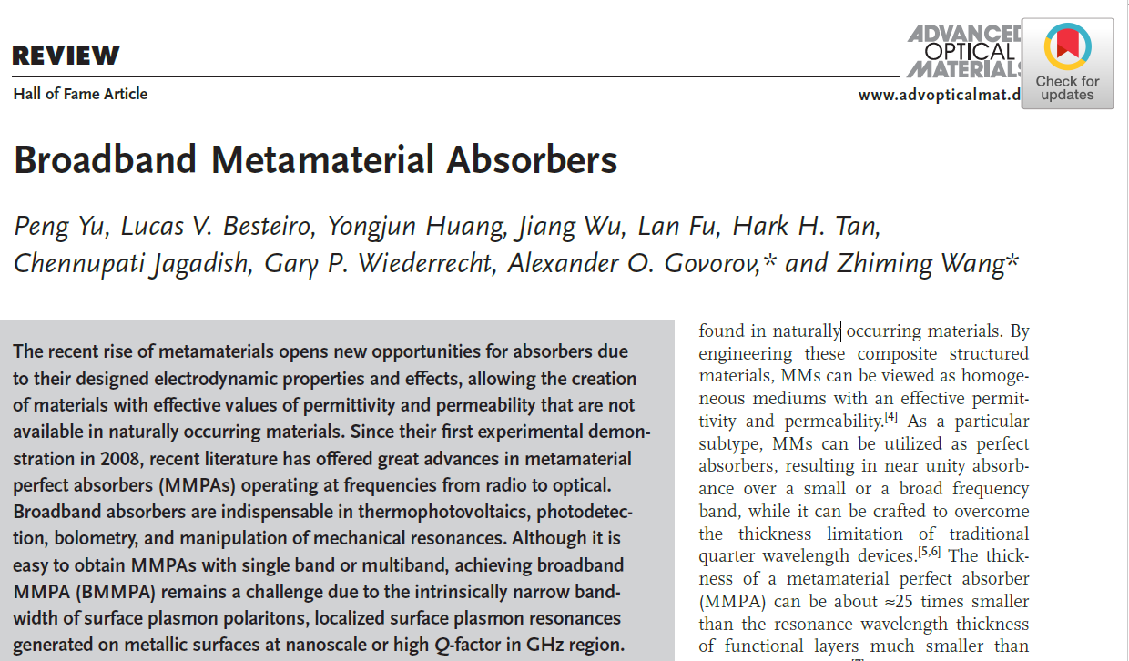
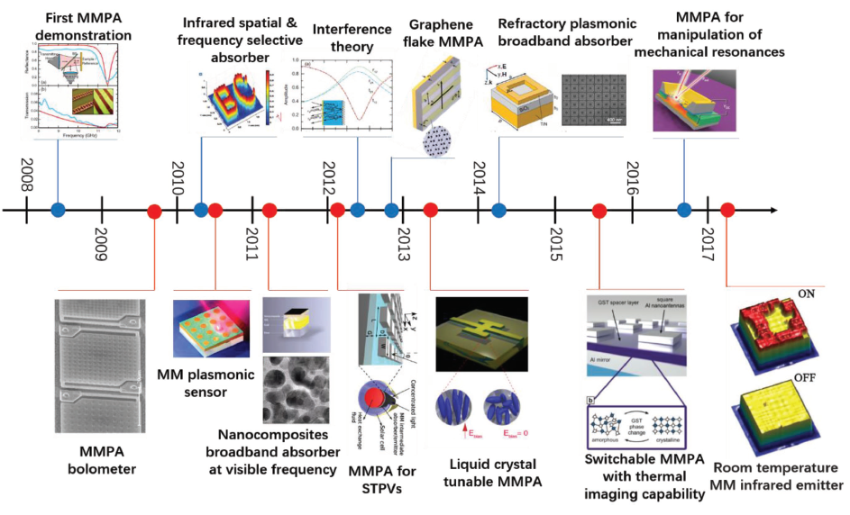
第二章 文献检索和综述
8. 既然是看图说话，怎么才能好好描述一个图？

Slide 38
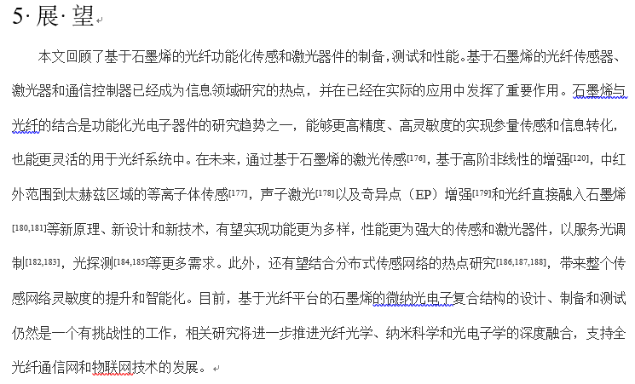
第二章 文献检索和综述
8. 结论怎么写？
结论是摘要的呼应提炼，所以应该写的像摘要
Why？
读者们靠结论记住你的文章
那和摘要有没有明显的区别？
有，区别在于结论具有展望性

Slide 39
第二章 文献检索和综述
9. 参考文献的融入和交叉引用
我们都注意到了，相比于别的文体，科技文献最重要的特征之一就是参考文献。
参考文献一般是公开发表的，大致分为如下几类：
期刊论文 [J]
图书和
图书章节 [M]
报刊和
新闻 [N]
会议论文 [C]
学位论文 [D]
专利 [P]
在哪里引用别人的研究成果呢？
对研究性论述，一般参考文献都集中在引言里
对综述性论述，分布在全文，但一般不出现在结论里
一个问题：引用了参考文献，就可以抄写原文了吗？
一个引用原则：转述。

Slide 40

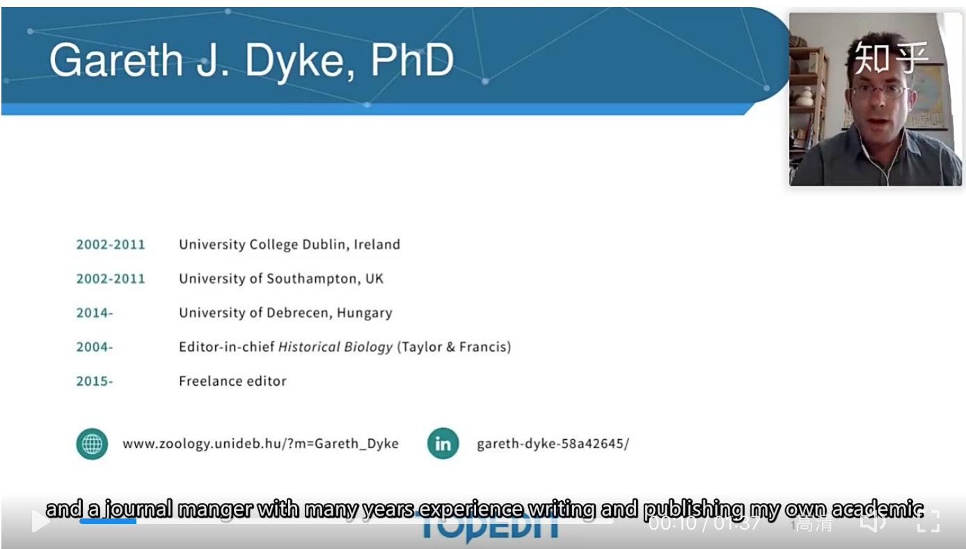
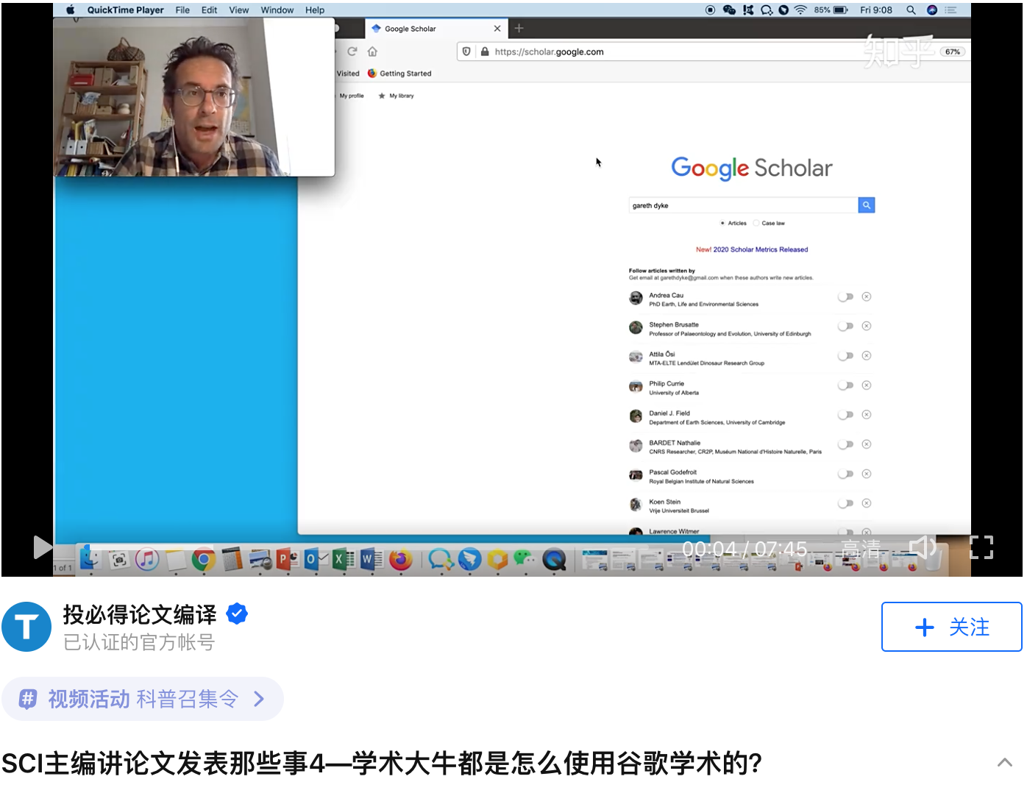
推荐视频链接（1）
SCI主编讲论文发表那些事（知乎）
盖瑞斯·戴克（Gareth Dyke）博士是一位高产的顶尖科学家，在过去20年中，共发表了280多篇SCI论文，其中5篇论文发表在《自然》和《科学》上，他也是是著名出版社“泰勒和弗朗西斯”旗下杂志《历史生物学》的主编。
https://www.zhihu.com/zvideo/1256256378407886848

Slide 41
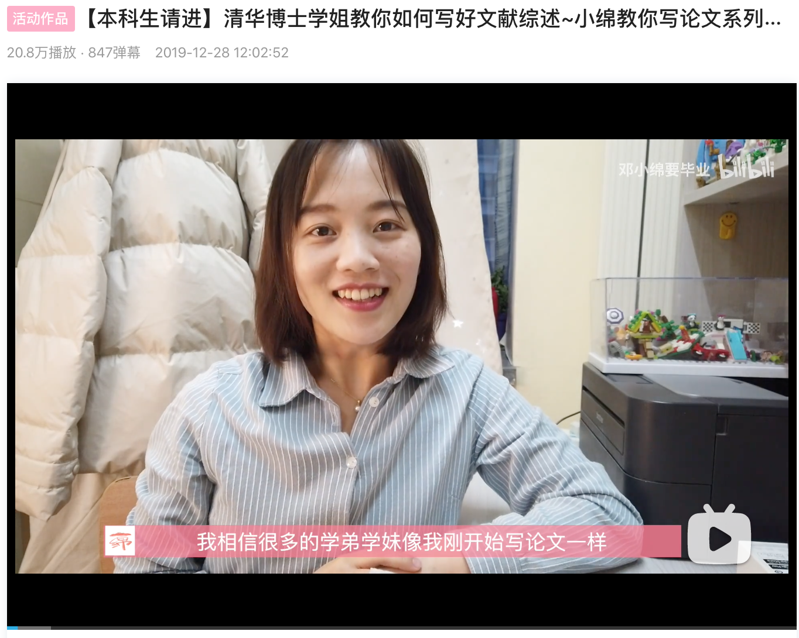

推荐视频链接（2）
【本科生请进】清华博士学姐教你如何写好文献综述
https://www.bilibili.com/video/BV1sJ411e7mv?from=search&seid=1357076816941607132

Slide 42

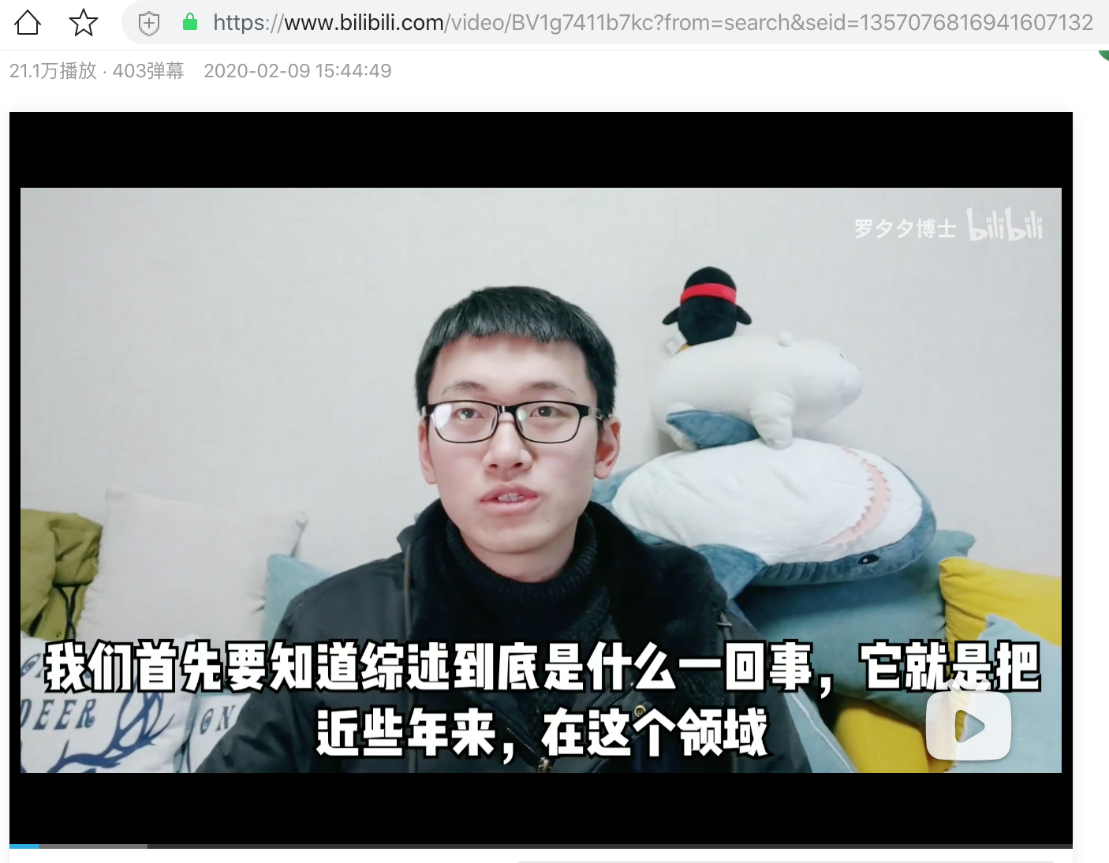
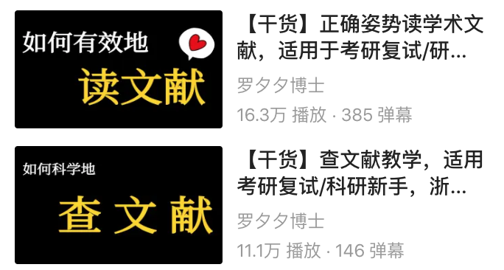
推荐视频链接（3）
【干货】如何写综述，浙大博士谈个人经验
https://www.bilibili.com/video/BV1g7411b7kc?from=search&seid=1357076816941607132

Slide 43
组织病理图像分析综述剖析
计算组织病理学中的深度神经网络模型综述

Slide 44
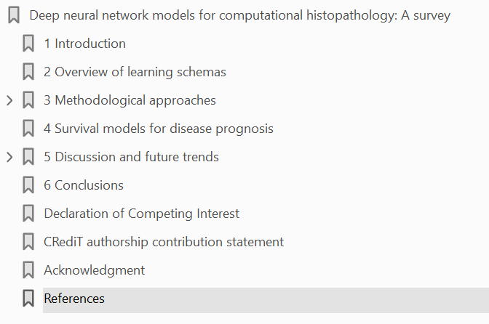
组织病理图像分析综述剖析
引入
学习模式回顾
方法
预后生存模型
讨论和趋势
结论
参考文献

Slide 45
组织病理图像分析综述剖析
1. 标题：
Deep neural network models for computational histopathology: A survey
2. 摘要：
Histopathological images contain rich phenotypic information that can be used to monitor underlying mechanisms contributing to disease progression and patient survival outcomes. Recently, deep learning has become the mainstream methodological choice for analyzing and interpreting histology images. In this paper, we present a comprehensive review of state-of-the-art deep learning approaches that have been used in the context of histopathological image analysis. From the survey of over 130 papers, we review the field’s progress based on the methodological aspect of different machine learning strategies such as supervised, weakly supervised, unsupervised, transfer learning and various other sub-variants of these methods. We also provide an overview of deep learning based survival models that are applicable for disease-specific prognosis tasks. Finally, we summarize several existing open datasets and highlight critical challenges and limitations with current deep learning approaches, along with possible avenues for future research.
组织病理分析
疾病机制
深度学习方法讨论

Slide 46
组织病理图像分析综述剖析
3. Introduction：
The examination and interpretation of tissue sections stained with haematoxylin and eosin (H&E) by anatomic pathologists is an essential component in the assessment of disease （组织解剖是看病的关键技术）
The first efforts to extract quantitative measures from microscopy images were in cytology （在细胞学研究中，首次从显微图像中提取了定量度量）
In 2011, Beck et al. (2011) demonstrated that features extracted from histology images could aid in the discovery of new biological aspects of cancer tissue, and Yuan et al. (2012) showed that features extracted from digital pathology images are complementary to genomic data （与癌症组织生物特性相关，与基因数据互补）
The analysis of whole-slide digital pathology images (WSIs) poses some unique challenges （全片分析具有特有的挑战性）
The remainder of this paper is organised as follows （各节安排）
起因
发展
困难

Slide 47
组织病理图像分析综述剖析
4. Overview of learning schemas：
In this section, we provide a formal introduction to various learning schemes in the context of DL applied to computational pathology.
In supervised learning
In weakly supervised learning (WSL)
The unsupervised learning
In transfer learning (TL),
Next, we discuss various deep neural network (DNN) models in each of these learning schemes published in histopathology do- main, along with the existing challenges and gaps in current re- search, and possible future directions in this perspective.

Slide 48
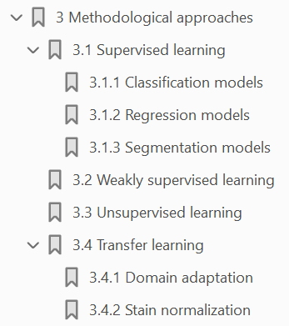
组织病理图像分析综述剖析
5. Methodological approaches:

Slide 49
组织病理图像分析综述剖析
5. Methodological approaches:
The aim of this section is to provide a general reference guide to various deep learning models applied in computational histopathology from a methodological perspective
5.1. Supervised learning
Among the supervised learning techniques, we identify three major canonical deep learning models based on the nature of tasks that are solved in digital histopathology: classification, re- gression and segmentation based models,
5.1.1. Classification models
(i) local-level tasks , and (ii) global-level tasks

Slide 50
组织病理图像分析综述剖析
5. Methodological approaches:
(i) local-level tasks
Image classification such as detection of cells or nuclei is notably one of the most successful tasks
The earliest seminal work proposed in Cire ¸s an et al. (2013) rev- olutionised the entire field of digital histopathology, by applying CNN based pixel prediction to detect mitosis in routinely stained H&E breast cancer histology images.
A promising alternative is to use a pre-trained network (trained on a vast set of natural images, such as Ima- geNet) to fine-tune on a problem in different domain with lim- ited number of annotations.
Recent studies have inves- tigated the use of crowdsourcing approaches to alleviate the anno- tation burden on expert pathologists.
The addition of multi-scale and contextual knowledge into CNN plays an essential role in identifying overlapping cell structures in histopathology images.
In summary, among the bottom-up approaches, CNN is the cur- rent gold standard technique applied to a wide variety of low- level histopathology tasks such as cell or nuclei detection

Slide 51
组织病理图像分析综述剖析
5. Methodological approaches:
(ii) global-level tasks
Most of the published deep learning meth- ods in this category focus on patch-based classification approach for whole-slide level disease prediction task
A few authors try to encode both local and global contex- tual information into CNN learning process for more accurate dis- ease prediction in WSIs.
This human visual attention mechanism can be modelled as a sequential learning task in deep learning using RNNs.
In essence, attention-based models are gaining popularity in re- cent years and have several intriguing properties over traditional sliding-window (patch-based) approaches

Slide 52
组织病理图像分析综述剖析
5. Methodological approaches:
5.1.2. Regression models
This category of methods focuses on detection or localization of objects by directly regressing the likelihood of a pixel being the centre of an object (e.g., cell or nucleus centre).
Deep regression models proposed in the literature are mainly based on either CNN or FCN architectures
Other authors adopted alternative methods by modifying the output layer of CNN, to include distance constraints or a vot- ing mechanism into the network learning process

Slide 53
组织病理图像分析综述剖析
5. Methodological approaches:
5.1.3. Segmentation models
Segmentation of histological primitives such as cells, glands, nu- clei and other tissue components is an essential pre-requisite for obtaining reliable morphological measurements to assess the ma- lignancy of several carcinomas
In order to determine an optimal model suitable for a given task, FCN with UNet architecture and found that better generalization ability and robustness was achieved us- ing a UNet model.
A few methods attempted to address this issue by leveraging the representation power of FCN with multi-scale feature learning strategies; to effectively delineate varying size objects in histol- ogy images.
Some authors have proposed variants of FCN to enhance seg- mentation - in particular at glandular boundaries, by compensating for the loss occurring in max-pooling layers of FCNs.
In com- puter vision, such problems can be formulated as an “instance- aware semantic segmentation”task

Slide 54
组织病理图像分析综述剖析
5. Methodological approaches:
Such mechanisms are in- tegrated into the FCN model by designing multi-magnification net- works， each trained on dif- ferent field-of-view image patches to obtain a better discriminative feature representation compared to a single-magnification model.
Therefore, some authors have proposed a variant of FCN which con- sists of a dense scanning mechanism, that shares computations in overlapping regions during image scanning

Slide 55
组织病理图像分析综述剖析
5. Methodological approaches:
5.2. Weakly supervised learning
The idea of weakly supervised learning (WSL) is to exploit coarse-grained (image-level) annotations to automatically infer fine-grained (pixel/patch-level) information
In this survey, we explore one particular form of WSL, namely multiple-instance learning (MIL), which aims to train a model using
a set of weakly labeled data
several papers on global detection based MIL method rely on alternative instance-level ag- gregation strategies to obtain reliable bag-level predictions suitable for a given histology task.
To tackle this issue, addi- tional weak constraints have been incorporated into FCN models to improve segmentation accuracy
Arguably, the most popular and clinically relevant MIL approach in histopathology is the global and local detection paradigm
There is a some disagreement among MIL methods regarding the accuracy of instance-level predictions, when trained with only bag-level labels
Not all methods identified as weakly supervised in the lit- erature necessarily fall under the MIL category

Slide 56
组织病理图像分析综述剖析
5. Methodological approaches:
5.3. Unsupervised learning
Most unsupervised approaches aim to maximize the probability distribution of the data, subject to some constraints, in order to limit the solution space and to achieve a desired grouping/clustering for the target task
Finally, we examine unsupervised transfer learning approaches, where instead of directly applying learned features on a target task, learned mapping functions are used as an initialization for target tasks, possibly with very few labeled training images.
Unsupervised learning methods are desirable as they allow models to be trained with little or no labeled data

Slide 57
组织病理图像分析综述剖析
5. Methodological approaches:
5.3. Transfer learning
The most popular and widely adopted technique in digital pathology is the use of transfer learning approach
In digital pathology, different types of staining are used de- pending on the application
5.3.1. Domain adaptation
Domain adaptation is a sub-field of transfer learning , where a task is learned from one or more source domains with la- beled data, and the aim is to achieve similar performance on the same task on a target domain with little or no labeled data
Fake (artificially generated) images are also used in domain adaptation

Slide 58
组织病理图像分析综述剖析
5. Methodological approaches:
5.3.2. Stain normalization
Stain normalization, augmentation and stain transfer are pop- ular image preprocessing techniques to improve generalization of a task by modifying the staining properties of a given image to match another image visually
One may combat staining variation by augmenting the train- ing data by varying each pixel value per channel within a prede- fined range on transformed color spaces, such as HSV (hue, satu- ration and value) or HED (Hematoxylin, Eosin, and Diaminobenzi- dine)
Although stain transfer methods produce aesthetically pleas- ing results, their use cases are still not entirely clear

Slide 59
组织病理图像分析综述剖析
6. survival models for disease prognosis
This section concentrates on methods of training survival mod- els that can either generate a probability of an event in a certain predefined period of time, or can predict time to an event using re- gression from a WSI
The data used to train survival models is weakly labeled, with only one outcome label per patient
There are many possible ways of aggregating the predictions for individual patches to give a single prediction for a patient
End-to-end methods that learn features directly from the im- age data and allow probabilities to be associated with individual patches can be used to uncover new information how morphology is related to outcome

Slide 60
组织病理图像分析综述剖析
7. Discussion and future trends
7.1. Effect of deep learning architectures on task performance
In most applications, standard architectures can be directly employed, and cus- tom networks should only be used if it is impossible to transform the inputs into a suitable format for the given architecture, or the transformation may cause significant information loss that may af- fect the task performance.
Pre-trained networks are widely employed but although pre- training is known to improve convergence speed significantly, it might not always lead to a better performance compared to a net- work trained from scratch, given enough time for convergence.
It is, however, not entirely clear how much of this increase can be attributed to the most recent advancements in neural networks, as opposed to proper validation, data mining and processing practices, or the general familiarity of researchers with DNN.
As such comparative studies have yet to exist for digital histopathology, we examined various public histopathology chal- lenges to assess the impact of the architecture, and found that in many tasks, the specific architecture was not a de- termining factor in the task objective outcome

Slide 61
组织病理图像分析综述剖析
It is noteworthy that all of the “winning networks ”for the var- ious challenges described above were invented on or before the year 2015, whereas challenge dates vary from 2016 to 2019. While challenge scores are not necessarily indicative of the use case per- formance, as the challenge participants tend to heavily fine-tune their models to achieve the highest possible score, these results indirectly indicate that simpler networks can still prevail, pro- vided that appropriate training practices are applied for the spe- cific problem at hand.
7.2 Challenges in histopathology image analysis
Standard DL architectures require their inputs (e.g., images) in a specific format with certain spatial dimensions. A reasonable data processing strategy aims to achieve minimal information loss while utilizing architectures to their maximal capacity.
In most applications, it is inevitable that input images will need to be tiled or resized.
Image pre- and post-processing can be used to boost the task performance of a DL model.

Slide 62
组织病理图像分析综述剖析
7.3 Quality of training and validation data
The success of DL depends on the availability of high- quality training sets to achieve the desired predictive performance
It is evident from this survey that a vast majority of methods are based on fully-supervised learning
One way to increase model robustness and improve generaliza- tion ability is to include diversity in the training data such as im- ages from multiple scan centres, images containing heterogeneous tissue types with variations in staining protocols
As the number of clinical centres adopting a fully digital work- flow increases, it is likely that the expectation will be that all dig- ital pathology models should be trained and tested on large, clini- cally relevant datasets.

Slide 63
组织病理图像分析综述剖析
7.4. Model interpretability
In recent years, DL based methods have achieved near human-level performance in many different histology applications, however, the main issue with DL models is that they are generally regarded as a “black box”.
One of the most overlooked issue with current DL models is the vulnerability to adversarial attacks.
Uncertainty maps have been used to identify the failure points of neural networks, and to increase the model interpretability.

Slide 64
组织病理图像分析综述剖析
7.5. Clinical translation
Despite this impressive array of applications, the real and impactful deployment of AI in clinical practice still has a far way to go. .
The main challenges and potential implications in transforming AI technologies from research to clinical use are as follows. First, the major bottleneck is the regulatory and privacy concern in get- ting ownership of the patient data such as images and personal health records.
Second, most AI algorithms suffer from inapplicability outside of the training do- main, algorithmic bias and can be easily fooled by adversarial at- tacks or by the inclusion of disease subtypes not considered during training.
Finally, the algorithms need to be in- tegrated into the clinical workflow

Slide 65
组织病理图像分析综述剖析
8. Conclusion
In this survey, we have presented a comprehensive overview of deep neural network models developed in the context of com- putational histopathology image analysis. The availability of large- scale whole-slide histology image databases and recent advance- ments in technology have triggered the development of complex deep learning models in computational pathology. From the survey of over 130 papers, we have identified that the automatic analysis of histopathology images has been tackled by different deep learn- ing perspectives (e.g., supervised, weakly-supervised, unsupervised and transfer learning) for a wide variety of histology tasks (e.g., cell or nuclei segmentation, tissue classification, tumour detection, dis- ease prediction and prognosis), and has been applied to multiple cancer types (e.g., breast, kidney, colon, lung). The categorization of methodological approaches presented in this survey acts as a reference guide to current techniques available in the literature for computational histopathology. We have also discussed the critical analysis of deep learning architectures on task performance, along with the importance of training data and model interpretability for successful clinical translation. Finally, we have outlined some open issues and future trends for the progress of this field.

Slide 66
我们的发现和未来工作
1。 综述的是2019年之前的论文
2。 补充2019年之后的论文和方法
如何补充：1）图书馆主页点击 SCI 库的高级搜索
2）输入关键词“pathology, pathological image, analysis, whole slide histopathology” 等，限定时间2019年后
3）阅读整理文献，并模仿写综述

Slide 67
综述范例剖析
Deep neural network models for computational histopathology: A survey
abstract
Histopathological images contain rich phenotypic information that can be used to monitor underlying mechanisms contributing to disease progression and patient survival outcomes. Recently, deep learning has become the mainstream methodological choice for analyzing and interpreting histology images. In this paper, we present a comprehensive review of state-of-the-art deep learning approaches that have been used in the context of histopathological image analysis. From the survey of over 130 papers, we review the field’s progress based on the methodological aspect of different machine learning strategies such as supervised, weakly supervised, unsupervised, transfer learning and various other sub-variants of these methods. We also provide an overview of deep learning based survival models that are applicable for disease-specific prognosis tasks. Finally, we summarize several existing open datasets and highlight critical challenges and limitations with current deep learning approaches, along with possible avenues for future research

Slide 68
综述范例剖析
Deep neural network models for computational histopathology: A survey
1. 怎么找进展?
We carried out this extensive review by searching Google Scholar, PubMed and arXiv for papers containing keywords such as (“convolutional” or “deep learning”) and (“digital pathology” or “histopathology” or “computational pathology”). Additionally, we also included conference proceedings from MICCAI, ISBI, MIDL, SPIE and EMBC based on title/abstract of the papers. We also iterated over the selected papers to include any additional crossreferenced works that were missing from our initial search criteria. The body of research in this area is growing rapidly and this survey covers the period up to and including December 2019. A descriptive statistics of published papers according to their category and year is illustrated in Fig. 1.

Slide 69
综述范例剖析
Deep neural network models for computational histopathology: A survey
2. 怎么描述进展
The remainder of this paper is organised as follows. Section 2 presents an overview of various learning schemes in DL literature in the context of computational histopathology. Section 3 discusses in detail different categories of DL schemes commonly used in this field. We categorize these learning mechanisms into supervised (Section 3.1), weakly supervised (Section 3.2), unsupervised (Section 3.3), transfer learning (Section 3.4). Section 4 discusses survival models related to disease prognosis task. In Section 5, we discuss various open challenges including prospective applications and future trends in computational pathology, and finally, conclusions are presented in Section 6.?

Slide 70
综述范例剖析
Advances of Deep Learning for Computational Histopathology: Principles and Applications
Abstract: With the remarkable success of digital histopathology, we have witnessed a rapid expansion of the use of computational methods for the analysis of digital pathology and biopsy image patches. However, the unprecedented scale and heterogeneous patterns of histopathological images have presented critical computational bottlenecks requiring new computational histopathology tools. Recently, deep learning technology has been extremely successful in the field of computer vision, which has also boosted considerable interest in digital pathology applications.

Slide 71
综述范例剖析
Advances of Deep Learning for Computational Histopathology: Principles and Applications
Deep learning and its extensions have opened several avenues to tackle many challenging histopathological image analysis problems including color normalization, image segmentation, and the diagnosis/prognosis of human cancers. In this paper, we provide a comprehensive up-to-date review of the deep learning methods for digital H&E-stained pathology image analysis. Specifically, we first describe recent literature that uses deep learning for color normalization, which is one essential research direction for H&E-stained histopathological image analysis. Followed by the discussion of color normalization, we review applications of the deep learning method for various H&E-stained image analysis tasks such as nuclei and tissue segmentation.

Slide 72
综述范例剖析
Advances of Deep Learning for Computational Histopathology: Principles and Applications
We also summarize several key clinical studies that use deep learning for the diagnosis and prognosis of human cancers from H&E-stained histopathological images. Finally, online resources and open research problems on pathological image analysis are also provided in this review for the convenience of researchers who are interested in this exciting field

Slide 73

综述范例剖析
Advances of Deep Learning for Computational Histopathology: Principles and Applications
怎么找进展?

Slide 74
综述范例剖析
Advances of Deep Learning for Computational Histopathology: Principles and Applications
2. 怎么描述进展
In this paper, we systematically review the research directions and challenges of deep learning methods for H&E-stained histopathological image analysis (shown in Figure 1). Our paper is organized as follows. In Section 2, we will briefly introduce the concepts and structure of the deep neural network. In Section 3, we will introduce the research direction of color normalization for the H&E-stained histopathological image analysis. In Section 4, we will summarize the literatures that applied the deep learning method for various H&E image segmentation tasks such as nuclei and tissue segmentation. In Section 5, we will review the clinical studies that apply H&E-stained histopathological images for the diagnosis and prognosis of cancer based on H&E-stained histopathological images. Finally, online resources and open research problems on H&E-stained histopathology image analysis are also provided in Section 6.

Slide 75
综述范例剖析
A survey on artificial intelligence in histopathology image analysis
Abstract: The increasing adoption of the whole slide image (WSI) technology in histopathology has dramatically transformed pathologists' workflow and allowed the use of computer systems in histopathology analysis. Extensive research in Artificial Intelligence (AI) with a huge progress has been conducted resulting in efficient, effective, and robust algorithms for several applications including cancer diagnosis, prognosis, and treatment. These algorithms offer highly accurate predictions but lack transparency, understandability, and actionability.

Slide 76
综述范例剖析
A survey on artificial intelligence in histopathology image analysis
Thus, explainable artificial intelligence (XAI) techniques are needed not only to understand the mechanism behind the decisions made by AI methods and increase user trust but also to broaden the use of AI algorithms in the clinical setting. From the survey of over 150 papers, we explore different AI algorithms that have been applied and contributed to the histopathology image analysis workflow. We first address the workflow of the histopathological process. We present an overview of various learning-based, XAI, and actionable techniques relevant to deep learning methods in histopathological imaging. We also address the evaluation of XAI methods and the need to ensure their reliability on the field.

Slide 77
综述范例剖析
Advances of Deep Learning for Computational Histopathology: Principles and Applications
怎么找进展?
search process using a combination of keywords in histopathology image analysis (such as histopathology, deep learning, computational pathology, digital pathology, artificial intelligence, and machine learning). We then used exclusion criteria to (a) only capture studies that considered AI algorithms applied and contributed to the histopathology image analysis workflow, and (b) focus on the application areas in histopathology. As a consequence, a total of 155 papers were selected and reviewed in this survey paper.

Slide 78
综述范例剖析
Advances of Deep Learning for Computational Histopathology: Principles and Applications
2. 怎么描述进展
The paper is organized as follows. Section 2 goes over the process of annotating histopathological data. Section 3 reviews the development of computational pathology before and after deep learning era with a focus on deep learning applications. Section 4 demonstrates the current/future research directions in computational pathology, including Scarce annotations problem, the importance of uncertainty quantification and explainability in future efforts and outlines some factors regarding actionability and its value in the medical workflow. Section 5 discusses the most common validation metrics that have been used for explainable techniques in computational pathology. Finally, Section 6 provides a brief summary of the paper.

Slide 79
第二讲 作业
模仿写一篇综述：
1）图书馆主页点击 SCI 库的高级搜索；
2）输入关键词“pathology, 或 pathological image, 或 analysis, 或whole slide histopathology” 等或它们的不同组合，限定时间2019年后，选择合适的相关文献；
3）阅读整理文献（从2020-2023，每年至少10篇，可以4人一组，每人负责一年10篇以上的文献），并模仿“Deep neural network models for computational histopathology: A survey”写综述(word文档）（要求写出文章的基本架构，每篇参考文献先以表格的形式归类）（tips: 文章类型可以在摘要或引言或结论中很快找到）
2.提交：将写的综述论文和参考文献一起打包发送到科代表***的邮箱：***@***，由科代表打包发到我的邮箱jqi@uestc.edu.cn(如无必要，请勿发此邮箱）

Slide 80
第二讲 作业
参考架构：尽量多用图
1. abstract
we review the histopathological image analysis literature from 2021-2023.背景、问题、做什么
2. introduction
问题重要，大量研究工作需要总结分类便于学习和理解，但是之前已有 不少文献进行了之前（2020）的综述，本文侧重于2021-2023
搜索方法介绍，主要内容按排
3.方法
分类描述（时间、种类），利用统计画图
4.数据及开源代码
图表
5.挑战问题及可能研究方向
图表
6.结论

